Slide 1

Let’s start with Allah Yaar
Bs in Computer Science

Slide 2
ICT (Information and Communication Technologies)
Information and Communication Technologies
Define:
Can be broadly defined as the means of creation, storage, management and dissemination of information by electronic means.
Those technologies that enable the handling of information and facilitate different forms of communication.

Slide 3
Main components of computer systems
The main components of computer systems in the context of Information and Communication Technology (ICT) include
1. Physical Component (Hardware)
Hardware refers to the tangible, physical elements of a computer or network system that support the functionality of ICT.
(a) Input Devices
(b) Output Devices
(c) Central Processing Unit (CPU)

Slide 4
Main components of computer systems
(d) Storage Devices
(e) Networking Hardware
Input Devices:
Devices like keyboards, mice, and scanners allow users to enter data into systems.
keyboards
The keyboard allows users to enter alphanumeric data (letters, numbers) and special characters into a computer, making it a primary tool for text-based data input in ICT applications

Slide 5
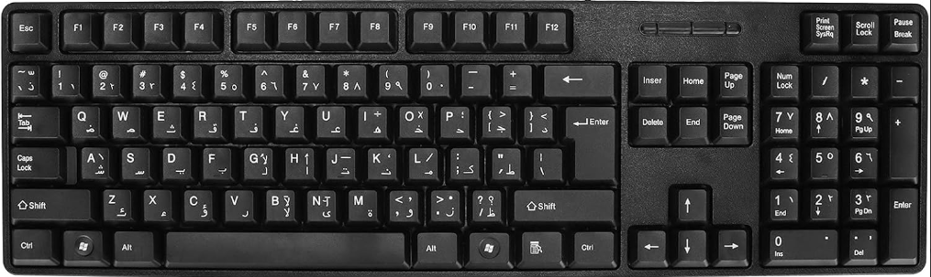
Physical Component
keyboards
It includes function keys (F1 to F12), control keys (like Ctrl, Alt, and Shift), and navigation keys (arrow keys) that help users perform commands and navigate within software applications.

Slide 6

Physical Component
Microphone:
the microphone is a key input device used to capture audio, enabling voice commands, communication, and multimedia content creation. The microphone is essential for voice communication in applications like video conferencing, VoIP (Voice over Internet Protocol), and online meetings. It allows users to speak and be heard.

Slide 7
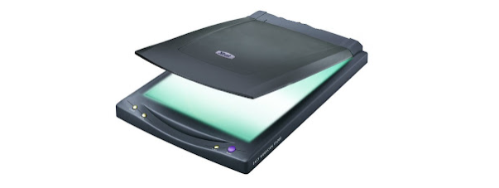
Physical Component
Scanners:
scanners are input devices used to convert physical documents and images into digital formats. This transformation from hard copy to digital data.

Slide 8
Physical Component
(b) Monitors, printers, and speakers help communicate processed data to users.
Monitors:
the monitor is a critical output device that displays visual information, serving as the primary interface through which users interact with digital content.
(i) LCD (Liquid Crystal Display) Monitors
(ii) LED (Light Emitting Diode) Monitors
(iii) OLED (Organic LED) Monitors
(iv) Touchscreen Monitors

Slide 9
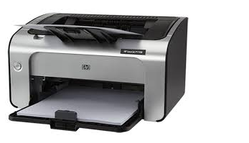
Physical Component
Printers:
a printer is an output device that produces a physical, tangible version of digital documents and images, enabling users to convert on-screen content into hard copies.

Slide 10
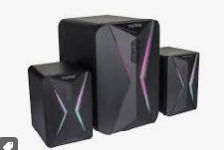
Physical Component
Speakers:
speakers are output devices used to convert digital audio signals into sound. They are essential for various applications, from multimedia playback to accessibility support, enhancing user interaction with digital content.

Slide 11
Physical Component
Central Processing Unit (CPU)
The brain of the computer where most calculations take place. that performs most of the processing inside a computer
Functions of the CPU
i. Execution of Instructions (The CPU executes instructions from programs and applications by performing basic arithmetic, logic, control, and input/output operations)
ii. Control Unit (CU) (It fetches, decodes, and executes instructions)
iii. Arithmetic Logic Unit (ALU) (performs mathematical calculations (addition, subtraction, multiplication, division))

Slide 12
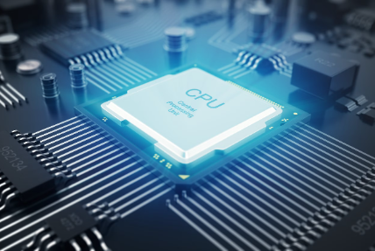
Physical Component
iv. Registers: These are small, fast storage locations within the CPU that hold data temporarily while it is being processed.

Slide 13
Physical Component
Storage Devices: Hard disk drives (HDDs), solid-state drives (SSDs), and cloud storage devices store data permanently or temporarily
Hard Disk Drive (HDD)
Solid State Drive (SSD)
Flash Drive (USB Drive)
External Hard Drive
Optical Discs
Magnetic Tape

Slide 14
Computer-Based Systems
These are complex systems that integrate hardware and software to perform specific tasks, often automatically and with minimal human intervention
Embedded Systems (Specialized systems in devices like medical equipment, automotive systems, and home appliances)
Control Systems (Used in industries for automation, process control, and real-time monitoring)
Enterprise Systems (Systems like ERP (Enterprise Resource Planning) manage large-scale data processing in businesses)

Slide 15
Software and Programs
Software is a set of instructions that directs hardware to perform specific tasks. It’s divided into system software, application software, and utility programs.
Types of Software:
System Software (Operating systems (like Windows, Linux, macOS) manage and coordinate hardware and software resources)
Application Software (User-oriented software such as word processors, email clients, and web browsers for specific tasks)
Utility Software (Programs that maintain, analyze, and optimize computer performance (e.g., antivirus programs, backup tools))

Slide 16
Communication Technologies in ICT
This component encompasses the technologies that facilitate data exchange, connection, and communication over networks.
I. Networking Hardware (Devices like routers, switches, hubs, and modems establish connections and manage data traffic between computers)
II. Protocols (Rules and standards for data exchange across networks, including TCP/IP for internet communication, HTTP for web traffic, and FTP for file transfer)
III. Internet and Wireless Technologies (Technologies such as Wi-Fi, Ethernet, 4G/5G, and Bluetooth enable wireless and wired connections)

Slide 17
Communication Technologies in ICT
IV. Cloud Computing (Services like SaaS (Software as a Service) and IaaS (Infrastructure as a Service) provide scalable data storage and application access over the internet)
V. Security Protocols (Encryption and security measures such as SSL/TLS, VPNs, and firewalls protect data and maintain privacy during data transmission)

